Slide 1
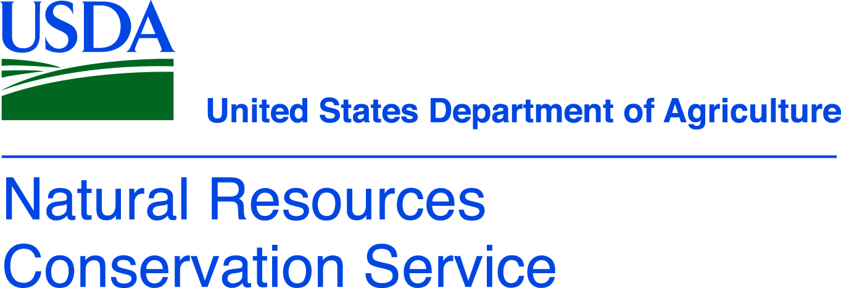
The Future of Soils

Slide 2
Goals of soil management
Improve productivity
Carbon sequestration
Improve connected ecosystems – air and water quality

Slide 3
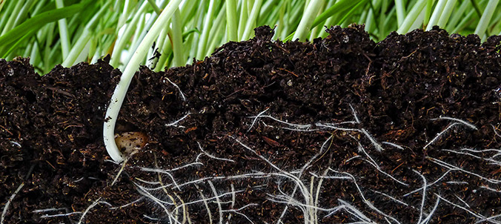
Improve productivity
Healthy rhizosphere biology can lead to increased plant productivity:
Improved nutrient cycling
Symbiotic relationships between plants, fungi, and bacteria
Plants can obtain 80-90% of their nitrogen needs from mycorrhizal fungi partnerships
Predator/prey relationships, for example between nematodes and bacteria, allow for nutrient availability
Improved energy cycling
Plants share carbon with their fungal and bacteria partners
30-40% of carbon created by photosynthesis can be exuded directly into soil via plant roots to nurture microbes
Improved plant health and ability to fight disease and parasites
Helpful bacteria can help ward off parasitic bacteria and other pests

Slide 4
Improve productivity
Increasing the carbon (organic matter) available in soil provides more food for the microbiome
Better developed microbiomes lead to improved plant health

Slide 5
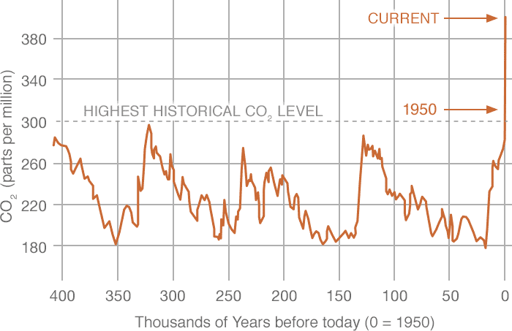
Sequester more carbon

Slide 6
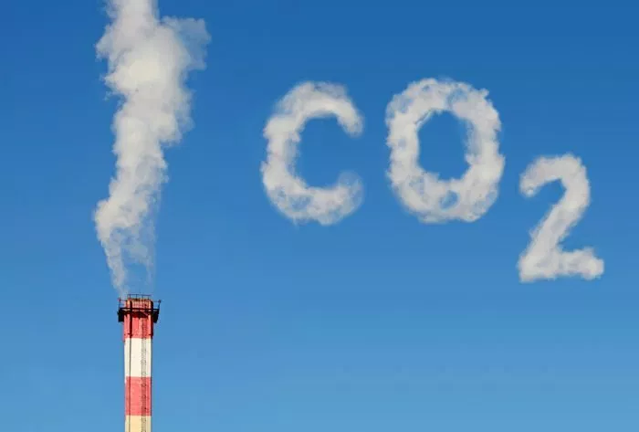
Sequester more carbon
Atmospheric carbon dioxide levels have fluctuated throughout Earth’s history between 175 and 300 ppm
Since humans have started burning fossil fuels CO₂ levels have steadily increased to 383 ppm in 2007 and more than 400 ppm in 2013
Some projections estimate levels will increase to 600 ppm by 2100
Plants AND the microbiome play and important role in the carbon cycle and carbon sequestration

Slide 7
Sequester more carbon
The Earth’s soils contain about 2,500 gigatons of carbon—that’s more than three times the amount of carbon in the atmosphere and four times the amount stored in all living plants and animals.
Currently, soils remove about 25 percent of the world’s fossil fuel emissions each year.
Because almost half the land that can support plant life on Earth has been converted to croplands, pastures and rangelands, soils have lost 50 to 70% of the carbon they once held. This has contributed about a quarter of all the manmade global greenhouse gas emissions that are warming the planet.
A 2017 study estimated that with better management, global croplands have the potential to store an additional 1.85 gigatons carbon each year—as much as the global transportation sector emits annually.
Some scientists believe soils could continue to sequester carbon for 20 to 40 years before they become saturated.

Slide 8
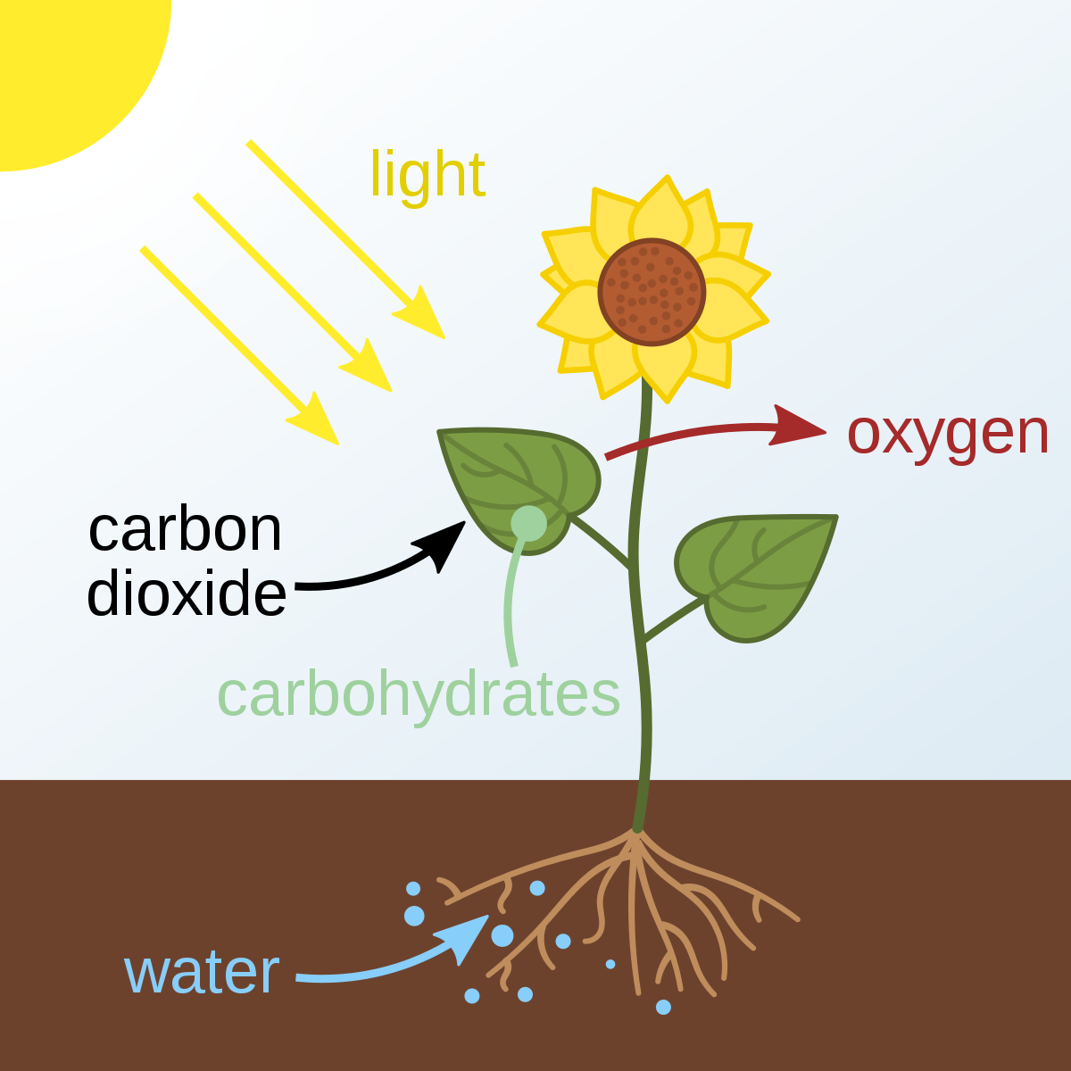
Sequester more carbon
Basic Steps in C0₂, Soil/Carbon Cycle
Photosynthesis: process where sunlight energy is transformed into biochemical energy – sugar called glucose. CO₂ from the air and water from the soil. Releases O₂ as a by-product.
Resynthesis: glucose is resynthesized into a variety of carbon compounds including carbohydrates, proteins, organic acids, waxes and oil
Exudation: 30-40% of carbon created by photosynthesis can be exuded directly into soil via plant roots to nurture microbes.
Respiration: carbon compounds created through resynthesis are used by plants, animals, or microbes to gain energy, grow, and maintain healthy systems. They respire carbon dioxide back into the atmosphere.
Humification: creation of humus, a chemically stable type of organic matter composed of complex molecules (carbon, nitrogen, minerals, and soil particles). Carbon not used in microbial respiration can be converted to humus.

Slide 9
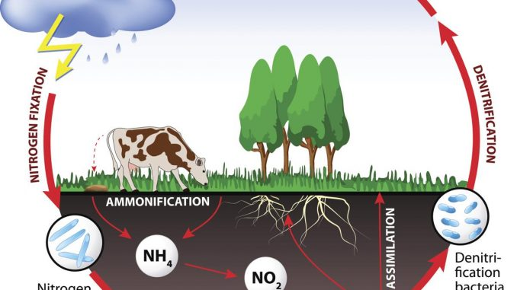
Improve connected ecosystems – air and water quality
Healthy plants mean that fewer pesticides need to be used to treat problem species. Less chemical application means less impact on adjacent ecosystems.
Improved microbiome – specifically for denitrifying bacteria – can lead to fewer nitrates leaching into the waterways. The bacteria return the nitrogen to the atmosphere in the stable N₂ form.
Improved microbiome can lead to quicker degradation of agrochemicals with less chance of leaching or run-off.
Improved microbiome can lead to more carbon capture and less atmospheric CO_{2.}

Slide 10
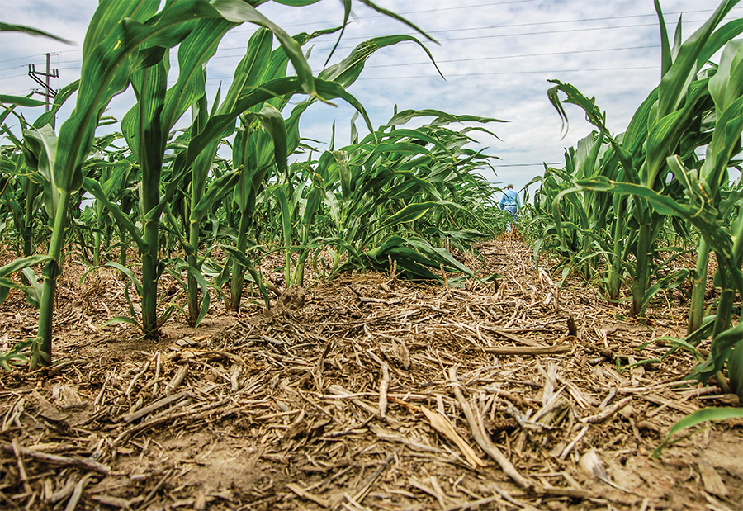
Best Management Practice - cropland
No-till planting or conservation tillage planting
Minimize disturbance of soil microbiome
Increase organic matter left on fields
Occasional tillage or conservation tillage
Changes soil temperature and moisture that can be more hospitable to some microbes
Can change the organic matter distribution in the soil making it available throughout the rhizosphere

Slide 11
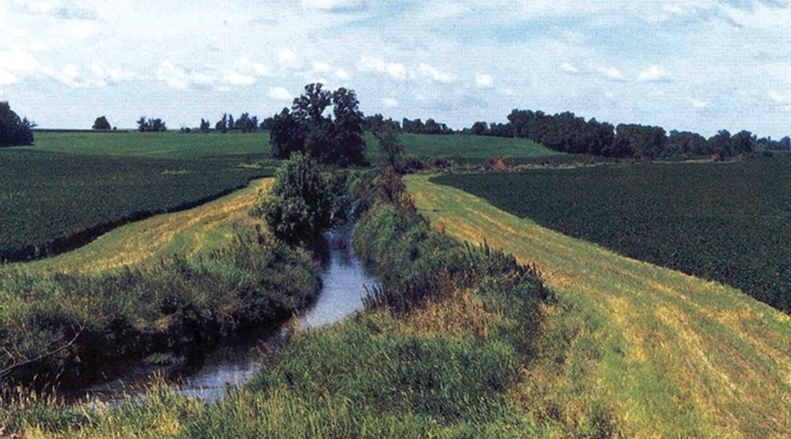
Best Management Practice - cropland
Fertility management
Add animal manure to increase organic matter
Apply soil amendments (fertilizer) based on soil tests and only apply where needed
Buffer strips along edge of field, terraces, grassed waterways, and prairie strips in fields
Slow water movement across fields
Minimize soil erosion from fields

Slide 12
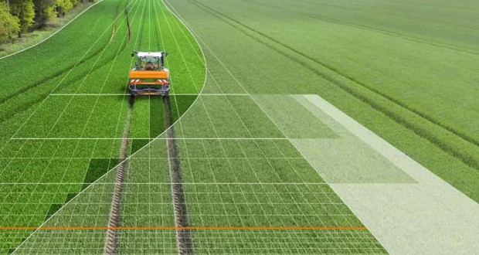
Best Management Practice - cropland
Precision agriculture
Minimizes machinery passes on the field which can then minimize soil compaction
Apply pesticides and fertilizers at the right time to maximize efficacy and minimize negative impacts
Perennial crops when possible
Promotes continued symbiotic relationships

Slide 13
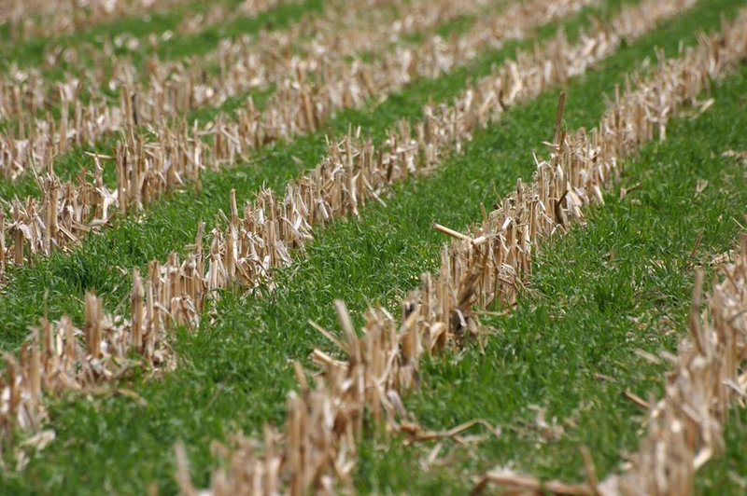
Best Management Practice - cropland
Crop rotation
Can influence quantity and quality of organic matter
Affects hosting ability
Breaks pathogen cycles
Promotes symbiotic relationships with different species
Cover crops
Help reduce erosion during fallow months
Promotes continual symbiotic relationship when cash crop is not actively growing
Helps store nutrients like phosphorus that could be lost during erosion
Helps build soil structure including macropore spaces
Helps reduce soil compaction from heavy machinery
Helps increase organic matter in soil

Slide 14
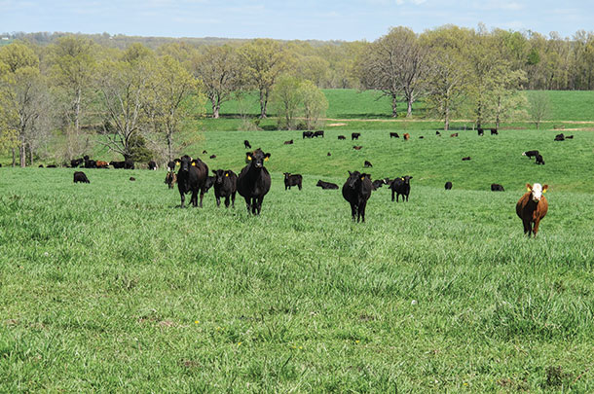
Best Management Practice - pasture
Manage stocking rates closely
Account for native grazers like deer and elk
Account for excessively dry years with low forage production
Manage access to water to minimize soil erosion
Manage access to things like mineral/salt blocks to ensure animals move across the entire pasture
Enhance riparian areas and manage natural water flow

Slide 15
Best Management Practice - pasture
Implement intensive rotational grazing
Small pastures with short durations of grazing
Mimics herds moving through the plains
Gives plant communities a longer time to rest and recover
Promotes perennials and reduces the spread of annual weeds
Incorporates manure into the soil which increases organic matter
Improves seed-to-soil contact for better germination

Slide 16
On the horizon…
Seed treatments to inoculate fields with a microbiome specific to the needs of that seed

